Slide 1
Recent Developments in Low Tech Resources at Ingfield Manor School

Slide 2
Background
Ingfield Manor is a non-maintained Scope school for pupils 3-19, most of whom have Cerebral Palsy
Throughout my 22+ years in the school, typically 70-80% of the pupils have needed AAC.

Slide 3
Background
Managing high and low tech strategy for that number of pupils - for many years with only one S&LT - required a strategic approach to stay abreast of demand for resources
we needed templates which could be customised, rather than starting from scratch for each pupil.

Slide 4
Background
A low tech strategy came before we started developing high tech IDV. This was in the days when cutting, copying, pasting, and colouring involved a photocopier, scissors, glue and felt tips.
A progressive series of 5 communication books, using PCS symbols, emerged
alongside a curriculum of weekly session plans to support the teaching of these.

Slide 5
Background
I have been asked to talk about recent developments in paper-based resources
5 out of 7 of the resources I will describe are rooted in what has been described above.

Slide 6
Recent Developments in Paper-Based Resources
Colour-Zoned books
Block Scanning books
Auditory Scanning pathway
Prox Pad books
Sensitive Vocabulary project
Sign & Symbol noticeboard & songbooks
Clue Boards

Slide 7
1. Colour-Zoned Books

Slide 8
Colour-Zoned Books
Whatever level of Ingfield Book a child is on, there are at least 24 pages of topic vocabulary
For the child who wants to turn pages, this involves a lot of page tabs
which, if all presented at once, are too small to be practical
and tend to be too flimsy to be durable

Slide 9
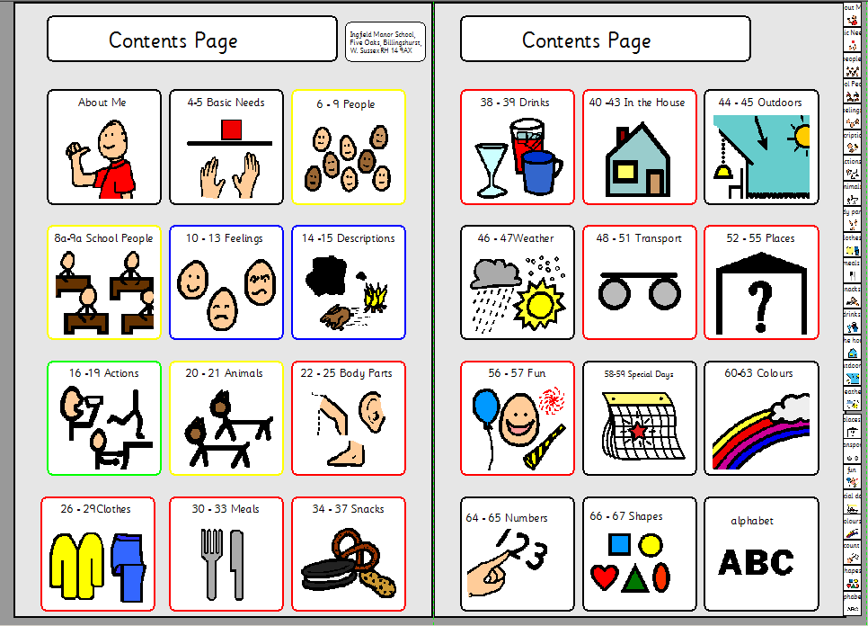
24 tiny, flimsy tabs. This is an early book – later books have even more categories.

Slide 10
Colour-Zoned Books
For those who can manage this strategy, the Contents Page is now divided into coloured zones
and the book is also divided into zones, separated by coloured tabbed card

Slide 11
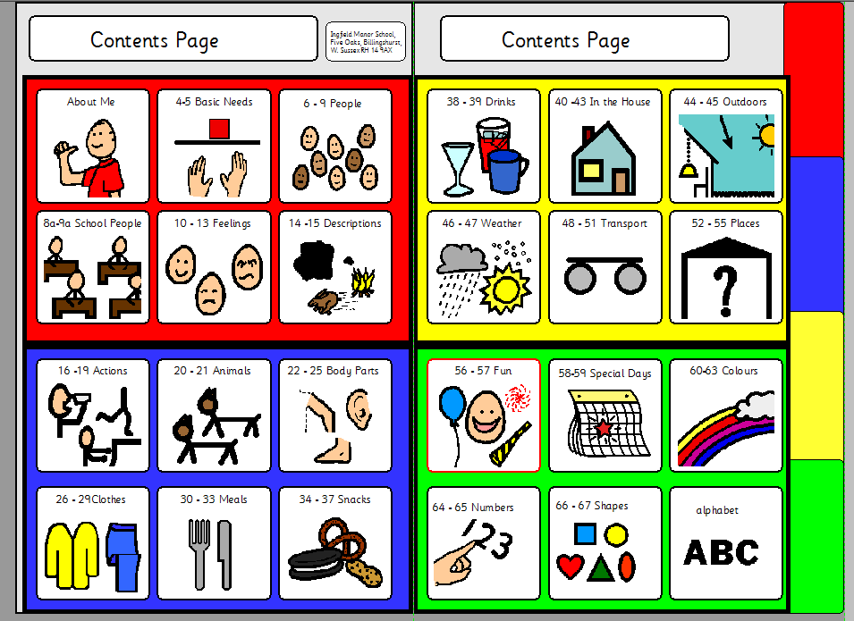
Pupils identify the coloured zone they need, and turn the relevant divider

Slide 12
Colour-Zoned Books
For example, if they need the Weather Page
They would first select the yellow divider tab, and then turn to that zone

Slide 13
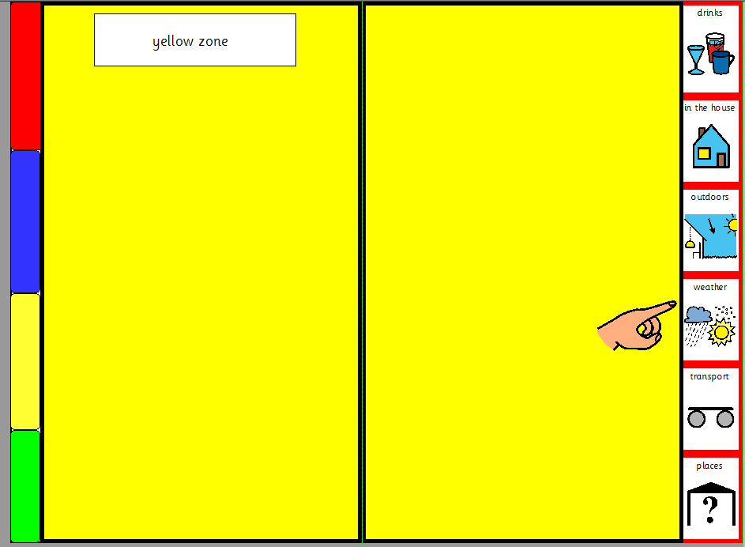

Tabs are now much more robust and easier to see.

Slide 14
Colour-Zoned Books
This strategy has proved more success ful than originally anticipated
To begin with, it was used with a handful of pupils who could turn pages, and who understood the zoning
However, it is now being used in many of the Early Years books, to reduce the number of options to visually scan when learning to categorise

Slide 15
Colour-Zoned Books
We don’t display more than 8 tabs at once – this means a new version is needed for more complex books, because the maths doesn’t work!
This will have 6 or more coloured zones
The books are time consuming to make
We have a CSVworking on this.
She is currently experimenting with different materials to reduce wastage and optimise robustness in making dividers for A5 books
We have been laminating card, but are hoping to use polypropylene

Slide 16
2. Block-Scanning Books

Slide 17
Block Scanning Books
These books were originally developed as a way of managing paper-based and high tech strategy in parallel
The book pages and onscreen grids are virtually the same
and block scanning is generally used for both
but in the paper-based version, the ‘cursor’ is a cardboard scanning window.

Slide 18
Block Scanning Books
However, the first version was intended for encoded access
The intention was that the first pupil would fist-point the block number first, followed by colour
A second child was encouraged use eye-pointing for the same method of encoding

Slide 19
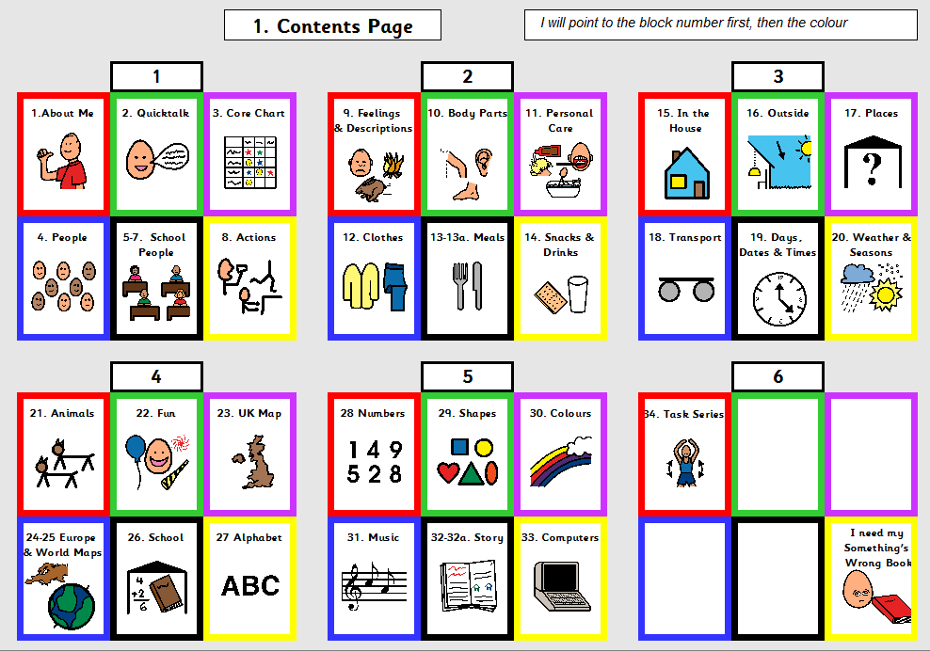
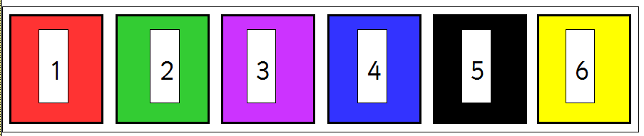
The book is displayed upright.
For fist-pointing, the number/ colour strip was presented flat at the foot of the book.
For eye-pointing number/colour cells were displayed around the top, side and lower edges of the book and/or on an etran frame

Slide 20
Block Scanning Books
The lass who was fist-pointing preferred to directly fist-point the blocks to using the numbers
but she used the coloured strip well to pinpoint which cell she was talking about.
There were some logistical difficulties, however, with the young man who was eye-pointing

Slide 21
Block Scanning Books
Firstly, in practice, communication partners in class are usually working alongside the pupils – not in front of them. Pupils will be looking at the teacher at the front of the class; but their AAC messages are usually interpreted by the person working alongside them.
Secondly, often this young man finds it difficult to hold his head in the mid-line. It can be difficult to interpret his eye movements

Slide 22
Block Scanning Books
He does, however, have a very clear yes/no response.
As an alternative to eye-pointing, we trialled the use of a ‘scanning window.’ This would be used to scan each block in turn until he indicated ‘yes’

Slide 23
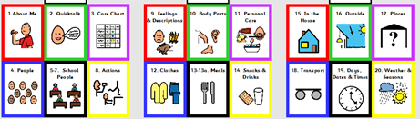
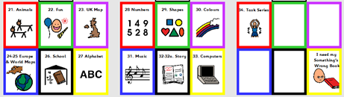

Block Scanning Books
The scanning window is first moved in sequence by the communication partner, until the pupil indicates ‘yes.’
Then the communication partner points to each cell in that block until the pupil indicates ‘yes’ again.

Slide 24
Block Scanning Books
He has indicated that he prefers this method to eye pointing
and staff who work with him confirm that it works well
He uses an e-tran frame for a number of activities
including as a mealtime ‘quick messages’ tool

Slide 25
Block Scanning Books
A huge advantage of this method for all the pupils who have this basic book layout is that it mirrors the way block scanning works on the computer.
The first 3 pupils to use this book worked together in a small communication group last year
The focus was on learning their way around their communication books.
This year, having learned to navigate their way around their books, they are focusing more on accessing the high tech version.
The work they did last year paved the way for understanding how block scanning works.

Slide 26
Block Scanning Books
A new spin-off from this book is being developed for use with eye gaze technology.
Looking anywhere in a block will navigate to a page consisting only of the 6 symbols in that block – effectively magnifying it.
The pupil will then make their selection on this second page.

Slide 27
Block Scanning Books
Although the block scanning book has undergone a number of permutations
the basic structure is rooted in the same books described at the beginning
Keeping a core structure helps us to develop a school-wide teaching strategy incorporating most communication book permutations

Slide 28
3. Auditory-Scanning Pathway

Slide 29
Auditory Scanning Pathway
The Auditory Scanning books used at Ingfield again share the same roots as other communication books and grids
2 students have outstripped original expectations by miles.
Both are expressing grammatically and semantically complex ideas, and are showing a determination to take control of their lives to a degree we hadn’t anticipated!

Slide 30
Auditory Scanning Pathway
This has resulted in a rethink on strategy relating to auditory scanning
resulting a 12-point pathway to ensure we start our little people on a defined route.
Work in progress,

Slide 31
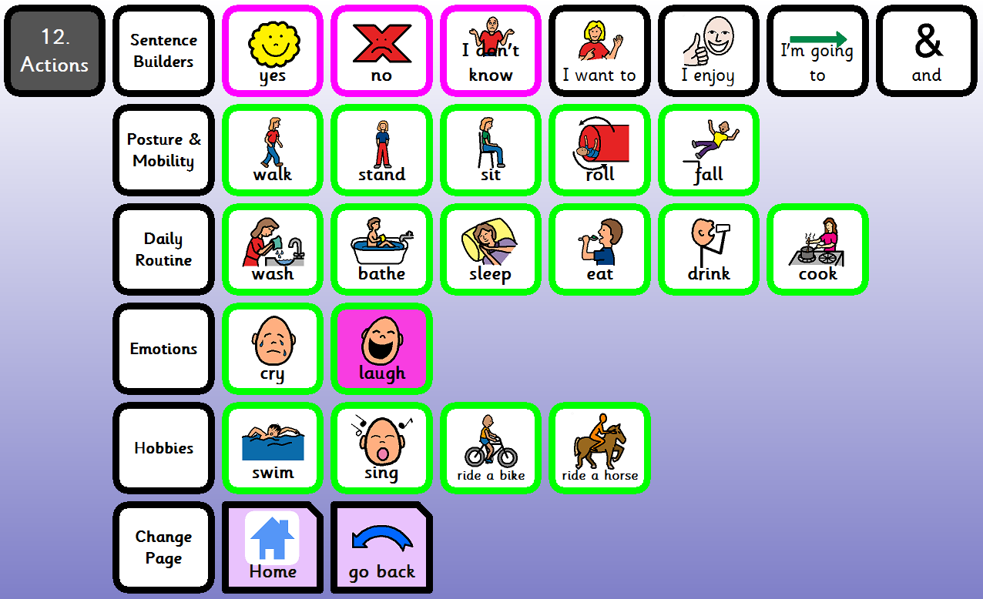
Auditory Scanning Pathway
Using this complex book, the communication partner will read down the row labels until the pupil indicates ‘yes.’
yes
yes

Slide 32
Auditory Scanning Pathway
This book is being used with pupils who have visual impairment
and also with 2 pupils who have constant involuntary head movements
For the latter pupils, positioning a book or screen in their line of sight, will often result in an involuntary head turn in the opposite direction.
Auditory Scanning reduces the pressure on maintaining stillness for sustained visual focus.

Slide 33
Auditory Scanning Pathway
Complex Auditory Scanning involves the ability to understand hierarchical categorisation
Main topic headings, followed by sub-topics
For example animals may first be subdivided into pets/farm/zoo etc
and then again into furry/not furry etc.
Not all topics are easy to give labels to
Whilst we have tried to apply transparent logic where possible, some things have just needed to be learned

Slide 34
Auditory Scanning Pathway
Primary pupils introduced to complex auditory scanning books 2 years ago used a weekly cutting and sticking activity, over the best part of a year, to sort symbols into rows, and learn their way around their systems.
We have learned a lot from working with this very able group of pupils who have surpassed expectations.

Slide 35
Auditory Scanning Pathway
We need to ensure younger pupils benefit from this experience – hence the identification of a pathway to plan and track progress.
It was especially helpful in raising expectations of one family with a toddler who had complex physical needs and visual impairment,
Despite very low expectations by professionals
their little boy achieved early steps in the pathway, and they were able to see a possible and realistic route forward for him

Slide 36
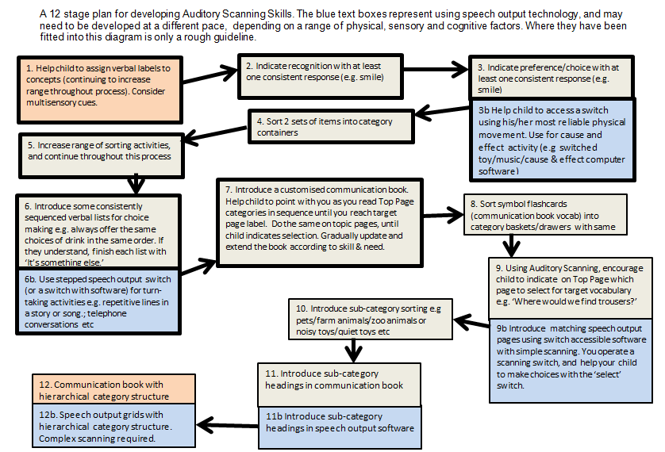

Slide 37
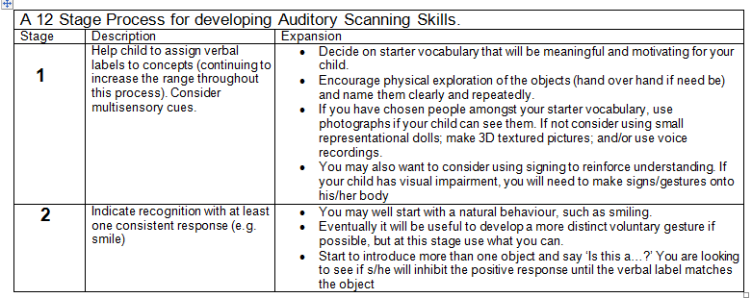
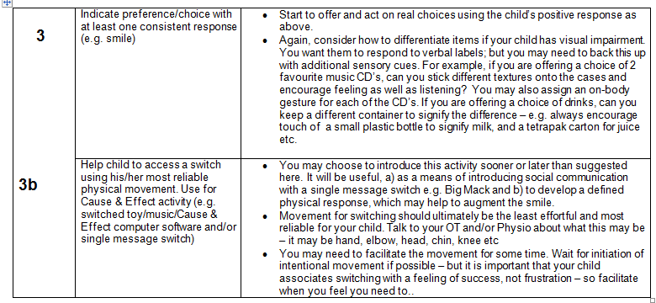

Slide 38
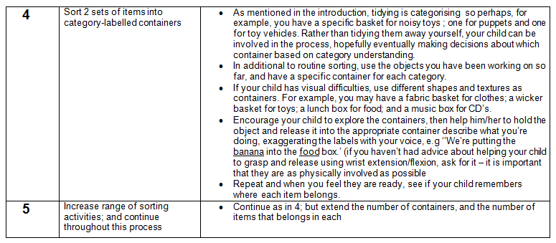
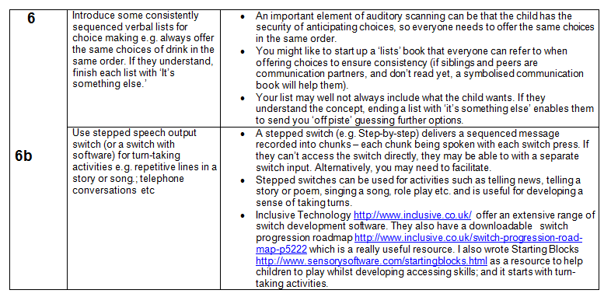

Slide 39
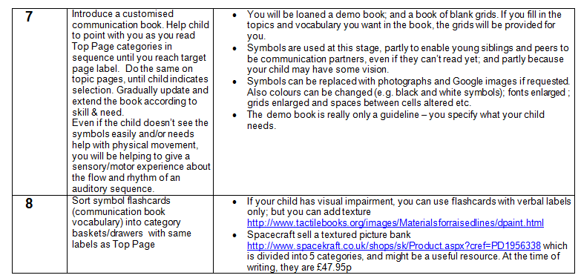
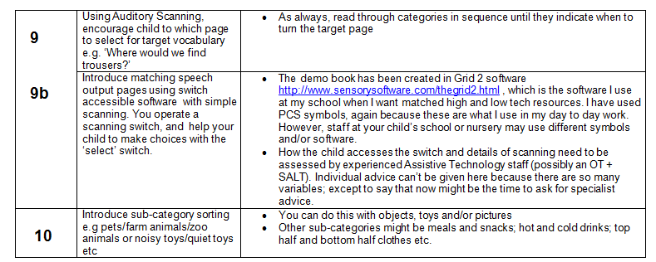

Slide 40
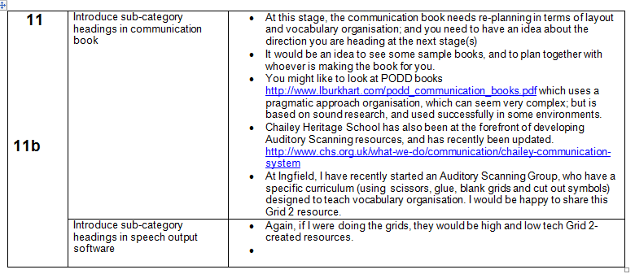
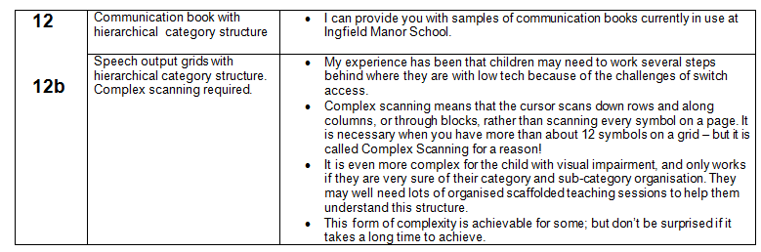

Slide 41
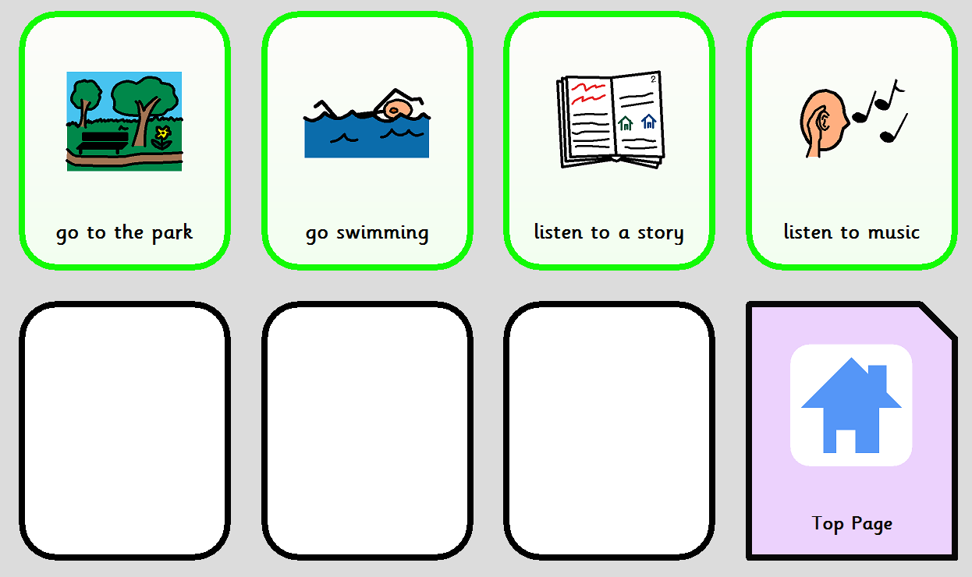
A page from a communication grid introduced with the young child, described previously, who had reached Stage 7 on the pathway.
This was created in the Grid 2, because his book and onscreen grids were the same
It was important that pictures/symbols are used (rather than text only) , so that his brother could use the book with him
At this stage, even if symbols are added to the second row, row labels aren’t needed, because you would use the equivalent of simple scanning.

Slide 42
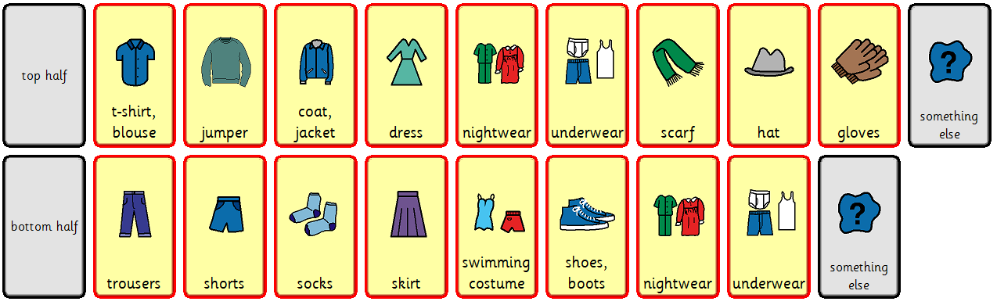
The boy using this book is being introduced to some pages with sub-categories, and is at Stage 11 on the pathway.

Slide 43
Auditory Scanning Pathway
One question we are asking ourselves is why do we use symbols in books designed for auditory scanning
and this is a good question.
The pupils who have difficulty in keeping their heads still use a combination of visual and auditory scanning, and they need the symbols.
An important point is also that some peers and siblings who cannot read are able to use the symbols to communicate.
However, for those AAC users who do not see the symbols, there is a feeling that the book can be a distraction.

Slide 44
Auditory Scanning Pathway
Some staff struggle with the concept of auditory scanning,
commenting on irrelevant visual aspects of symbols and page displays.
In addition to training, the answer may be to replace symbols with text.
However, if this means that peers and siblings cannot use the book effectively, better strategy may be to instruct staff to read the books on their laps, rather than on display to the pupil listening.

Slide 45
4. ProxBooks

Slide 46
ProxBooks
One early variant of our 1x2 books was a ‘Flashcard Book’
To give an idea how long ago this was – symbols were displayed in plastic floppy disk pockets
We hadn’t heard of PECs then, but Flashcard Books were used with pupils for whom picture exchange was more motivating than pointing.

Slide 47
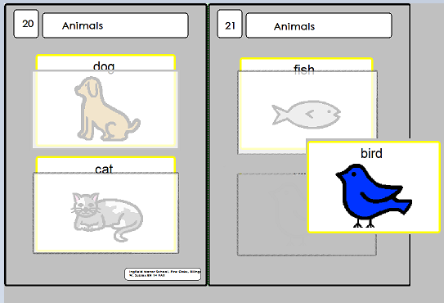
ProxBooks
The same vocabulary was available as in a 1x2 book, and laid out in the same way;
but it consisted of movable laminated symbols, stored in plastic pockets.

Slide 48

ProxBooks
The next planned variant of this book layout will one using recorded ProxPad tags
adding a speech output dimension to an old format
As the child hands over the tag (or the tag attached to an object), it will speak if placed on or ‘swiped’ over the ProxPad.

Slide 49
5. Sensitive Vocabulary Project

Slide 50
Sensitive Vocabulary Project
Some years ago, staff from Treloars School and College, and from Ingfield Manor School worked together on a collaborative project,
looking into ways of enabling pupils to discuss and disclose sensitive topics using AAC without being led
The project wasn’t about graphic images; but about how to embed and teach more generic vocabulary that could be used for disclosure.

Slide 51
Sensitive Vocabulary Project
The initial project folded before completion
For Ingfield, there 2 significant outcomes – ‘Something’s Wrong’ Books, and staff advocates chosen by the children.
Recently we have decided to pick up the project again at Ingfield, and look at how we can develop our paper-based and high tech resources to facilitate safeguarding

Slide 52
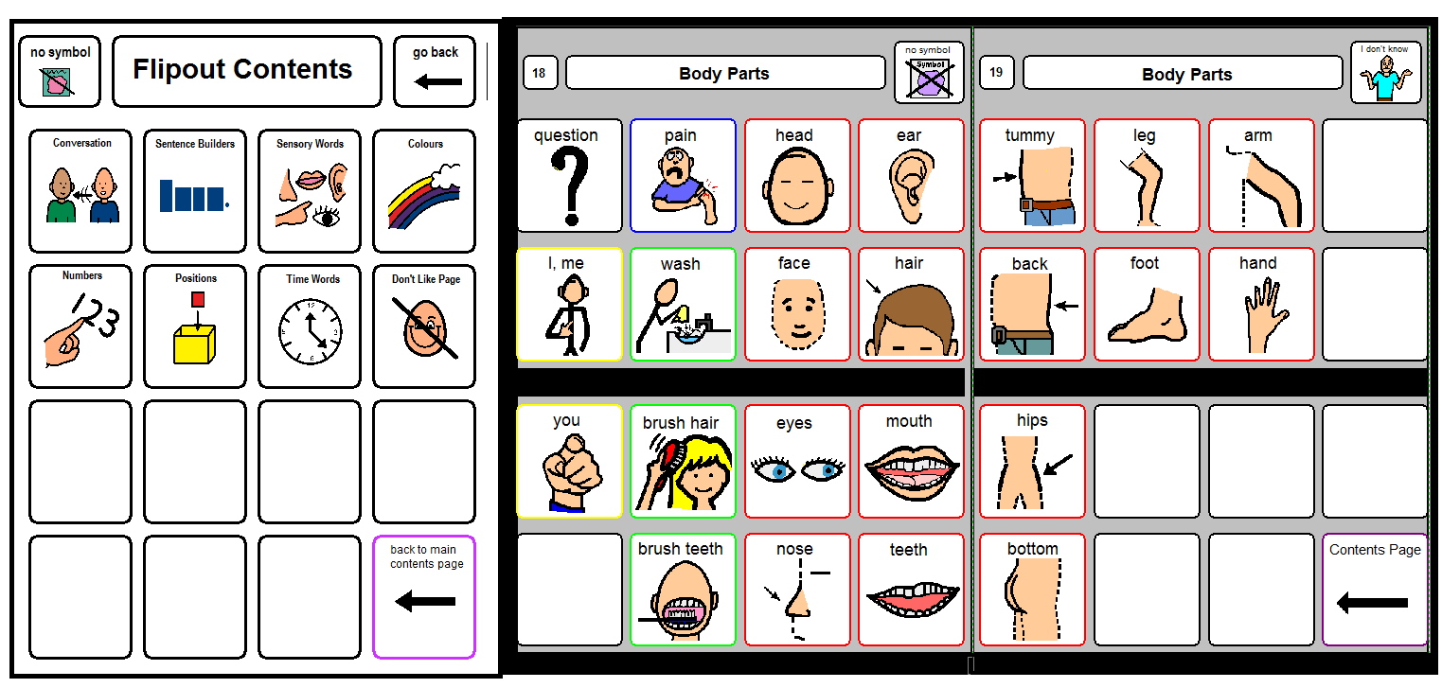
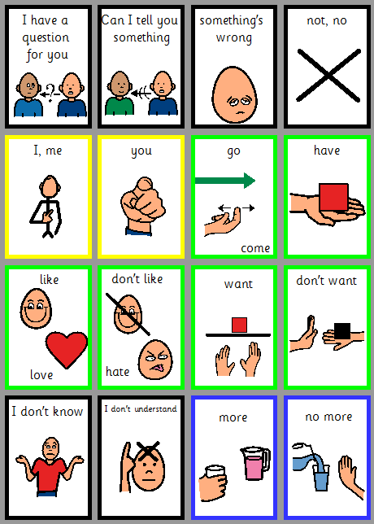
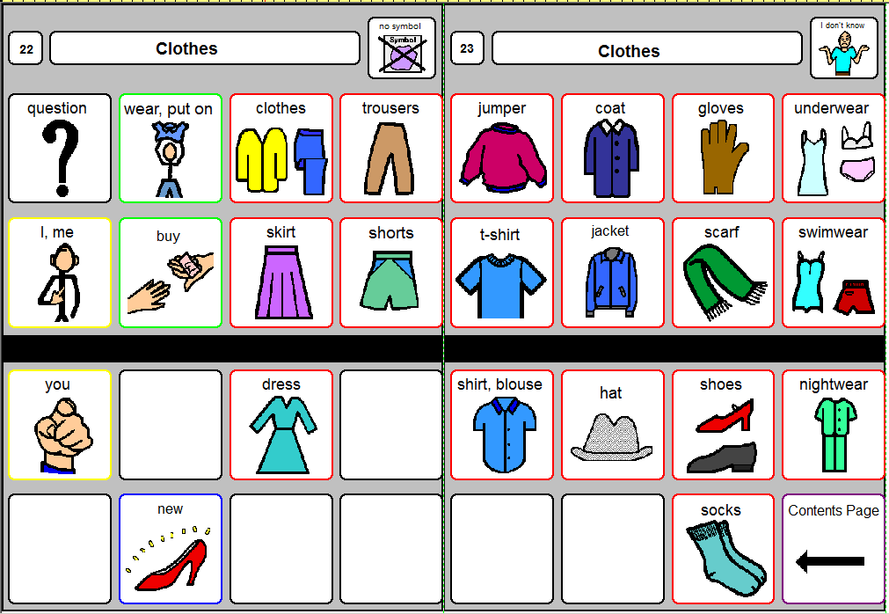
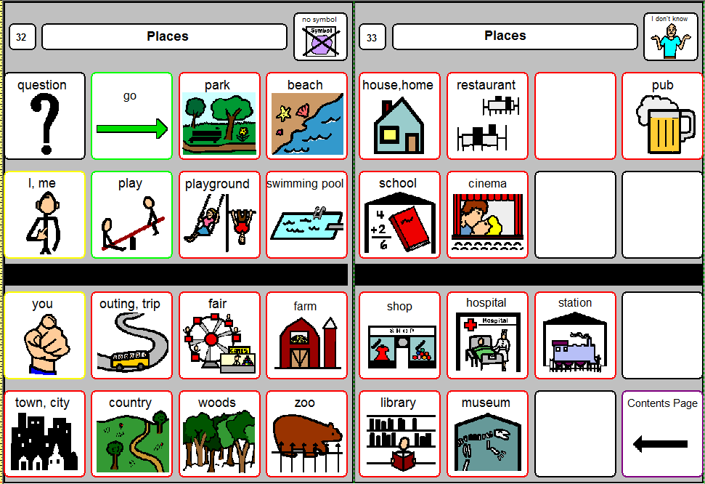
The main strategy is to develop our ‘flipout sheets,’ which extend to the side of our books and are used alongside any page

Slide 53
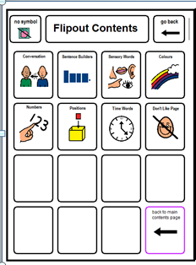
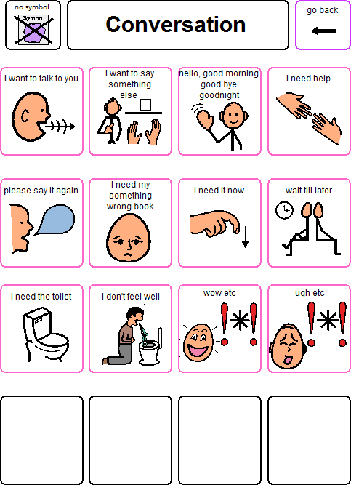
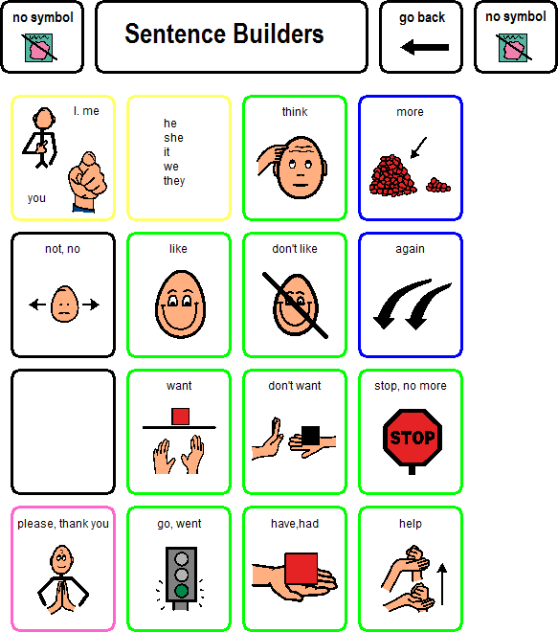
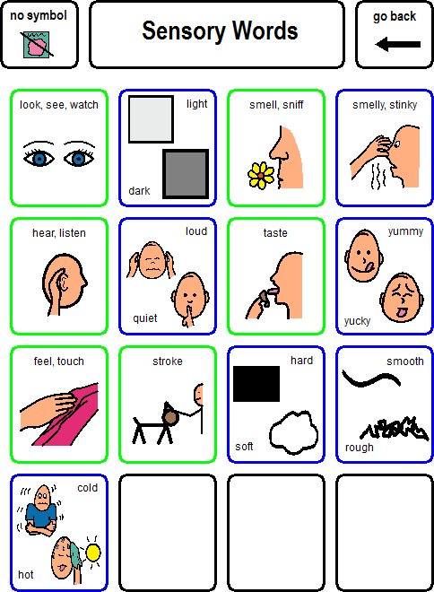
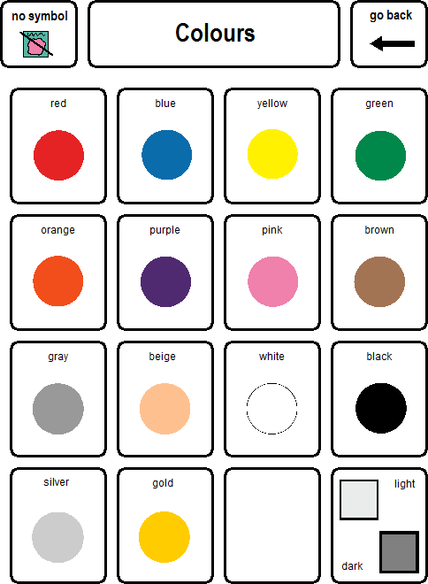
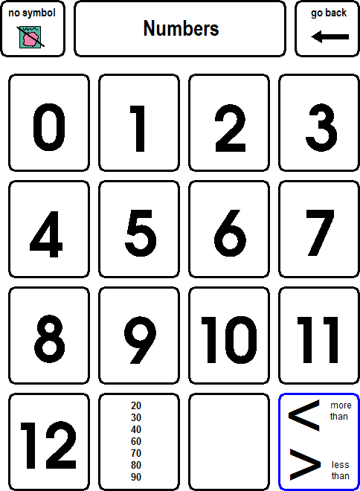
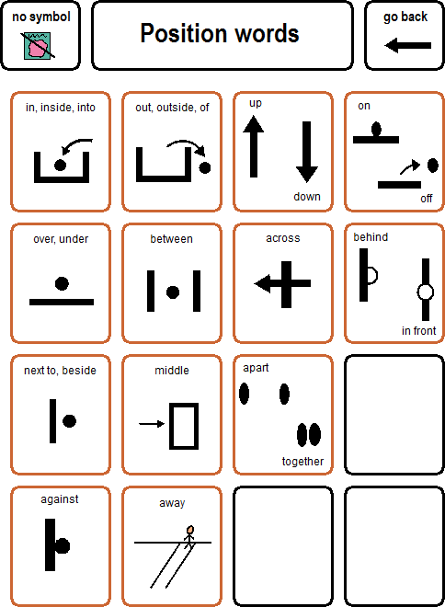
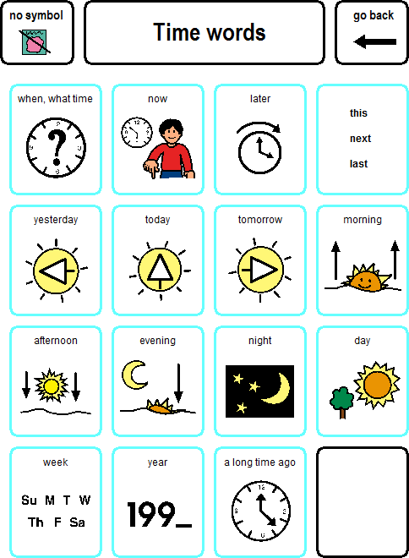
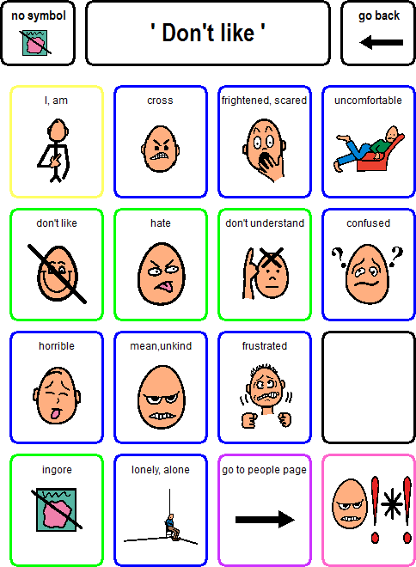
Working with a former pupil and AAC user, we have agreed a set of flipout pages which embed non-explicit words, that might be used for disclosure

Slide 54
Sensitive Vocabulary Project
We have a long way to go in this project
For example, we have focused on vocabulary for the 4x4 book – how will this be adapted for younger pupils and those with simpler books?
How do we ensure the flipout vocabulary is learned?
Are the books practical to use and produce?
Also, there is work being done to develop resources for those who do need and want more explicit vocabulary

Slide 55
6. Sign & Symbol Noticeboard & Songbook

Slide 56
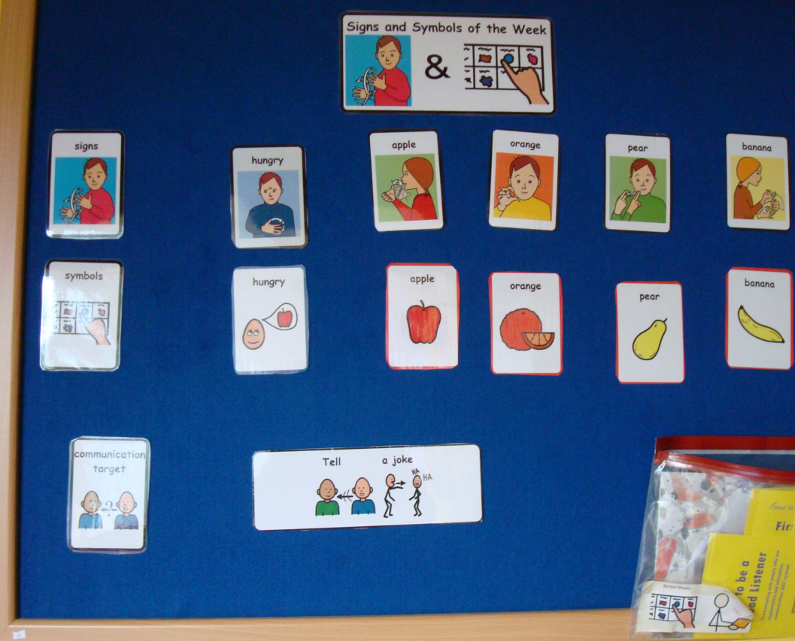
Sign and Symbol Noticeboard and Songbooks
Outside the S&LT Room is a noticeboard, on which are displayed signs and symbols of the week + a functional communication target
The primary purpose is to ensure that the teaching of signs and symbols is embedded into different situations throughout the week; and that staff don’t forget that AAC is not just about answering questions.

Slide 57
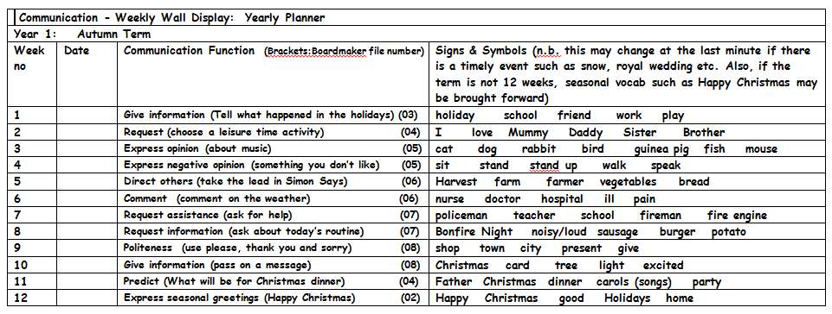
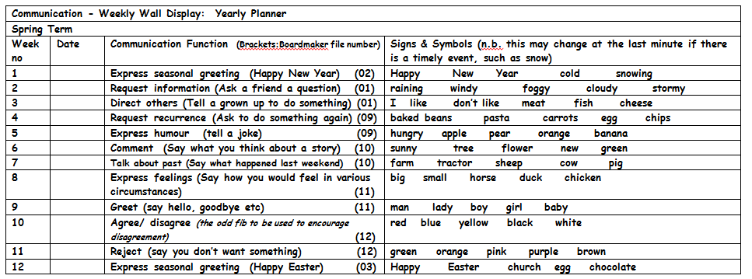
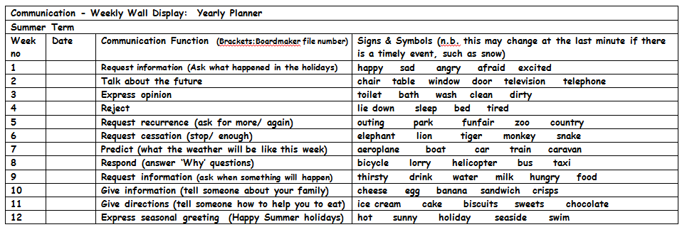
Sign and Symbol Noticeboard and Songbooks
Vocabulary and Communication Functions to be covered are incorporated into annually recurring plans

Slide 58
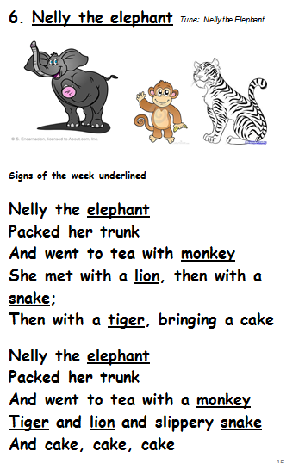
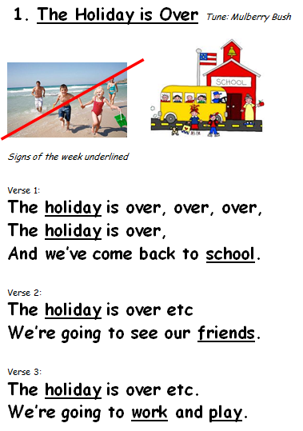
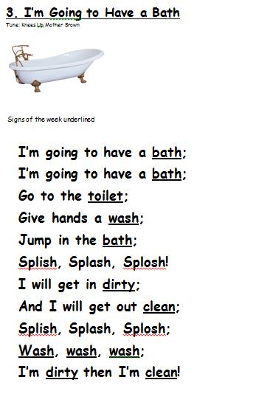
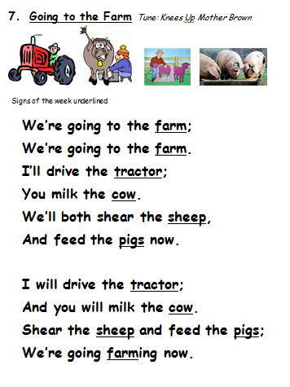
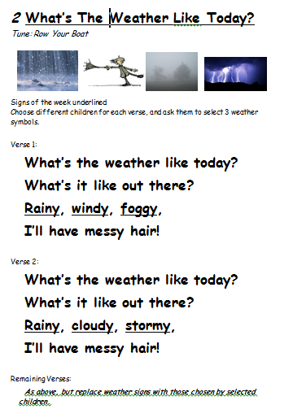
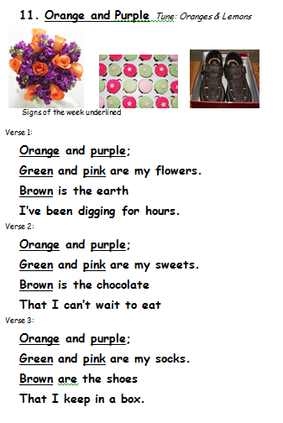
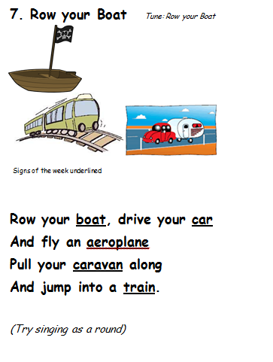
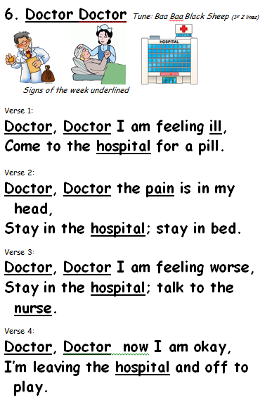
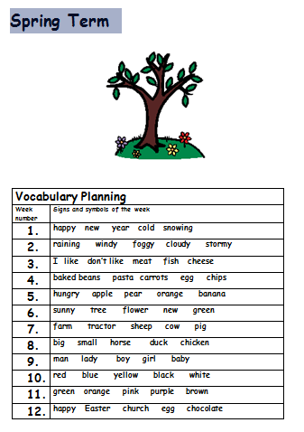
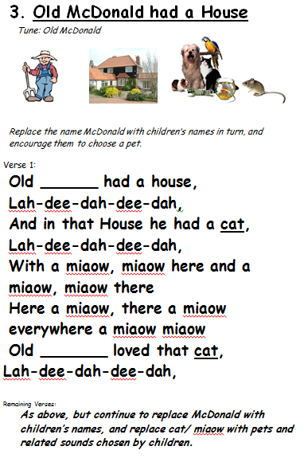
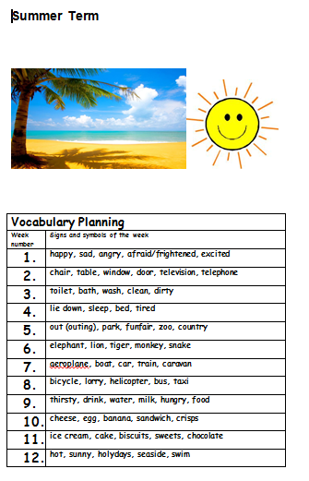
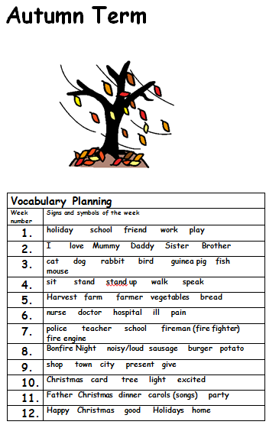
Sign and Symbol Noticeboard and Songbooks
and for each week, the signing and symbol vocabulary has been incorporated into a song, using tunes which should be familiar to most staff

Slide 59
7. Clue Boards

Slide 60
Clue Boards
One of our weekly primary communication group sessions is the Speaking and Listening Group
These are pupils who have some functional speech, but with intelligibility issues
and who all have sufficient phonological awareness to be working towards the use of word prediction for functional communication

Slide 61
Clue Boards
In 2012-13, group sessions were focused on the following areas:-
assessment of initial sound awareness for differentiation
Word Prediction workbooks
segmentation of polysyllabic words (to increase confidence in using word prediction for long words)
conversational repair strategies, including identification and repetition of keywords

Slide 62
Clue Boards
This is continuing in 2013-14, except that there has been some emphasis on using the Clue Board – a paper-based tool for conversational repair.
Again, it has been emphasised that repetition of keywords is often more effective than repetition of whole sentences if misunderstood.
If the keyword is not understood, the Clue Board may be helpful
to give a semantic clue by using category labels
to give the initial letter(s) of the words

Slide 63
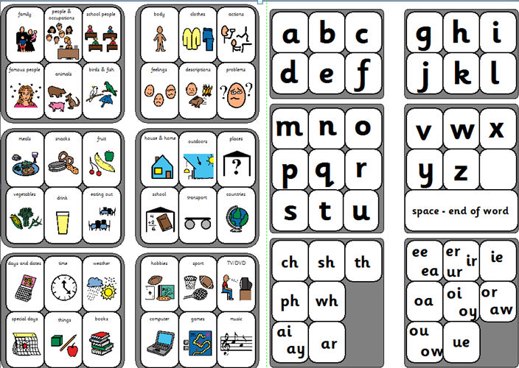

Slide 64

One pupil in the group needs this more advanced spelling board, and not the category cues, because her spelling is so good. This proved really useful when she transitioned to a new dual placement in a mainstream school, and people were not tuned into her speech. This is a useful backup when she doesn’t have technology to hand.

Slide 65
sally.conner@scope.org.uk
http://www.scope.org.uk/help-and-information/publications/aac-module-10

