Slide 1
The Adult AAC Service in Gloucestershire
Katherine Broomfield
Speech and Language Therapist
May 1st 2014

Slide 2
A spoke revolution?
Notes:
As we heard first thing this morning – this is an exciting time for AAC
Current changes in funding structures are addressing some of the inadequacies in service delivery and ensuring access to aids for people with the greatest need.
90% of AAC need will need to be provided by spoke services
DoE project mapping AAC services identified:
that less that 10% of services providing AAC spend over 90% of their time doing AAC
66% of services did not provide powered aids on a long term basis from their service budgets
89% of services felt that the loan banks available were insufficient to meet the service need
As an SLT working in a local AAC service, the following are some of the questions that have emerged in discussions I have had with other professionals working in local services:
1) What are the implications of establishing specialist hubs for local AAC services both existing teams and for the future (new teams?)
2) Where will funding come from? Will CCGs find extra cash for local services or will it need to be found from local budgets?
3) Will local services be able to evolve? Will new teams be custom built? What will be the expectation from hubs and how will that impact the way we are currently working?
4) What does 90% mean? Sounds like a big number but how will it break down?
5) What will it mean to be a spoke????
Not all questions for this presentation, but some food for thought. Keep them in mind for discussion/questions?

Slide 3
Gloucestershire Adult SLT AAC team: A model spoke?
Background
How?
Who?
What?
Notes:
I have been asked to present on the current local adult SLT AAC service in Gloucestershire. The aim of this presentation will be:
To provide an historical context to the existing service
What does the AAC team in Glos consist of – the main characters and costs
Our service specification at present.
How we do it:
Care pathway
Equipment
Governance
Training

Slide 4
Gloucestershire Adult SLT AAC team: A model spoke?
Outcomes
Notes:
What impact does this service have on local AAC service users?
How we interact with our local hub service?
How we are hoping to develop our service

Slide 5
An historical perspective
£10000
£10000
£10000
Notes:
Historically (1990s) the health trusts in Gloucestershire put £10000 each towards AAC provision
The were SLTs in Glos at the time with an interest in AAC but no one with a dedicated role

Slide 6
An historical perspective
1993
Notes:
Cathy Harris moved to the area in 1993 and, in conjunction with the then SLT service manager developed the specialist AAC post which was later banded via agenda for change.
The aim of the service was to provide care closer to home and to reduce lengthy waits and long journeys to the regional specialist centre.
Subsequent changes in trust configurations and boundaries, coupled with a tenacious service manager, resulted in the monies staying with the post.

Slide 7
An historical perspective
£
£
£
Notes:
Cathy developed the service to include involvement in the band 5 rotation and development of an assistant post in the department.
Subsequent service managers have continued to recognise the importance of AAC and consequently honoured the availability of the monies for procurement of AAC devices.

Slide 8
Local services in Gloucestershire
Star college
CIT
South West AAC Hub
Adult SLT AAC team
Gloucestershire
Special Schools
Notes:
To put our service in context…
There are several other AAC services in Gloucestershire. You have heard from Nicki, from the Communication and Intervention Team, already.
I mention the Star College here as they are another service that we have some interactions with when students leaving the college remain in the county and require follow up.
I am aware of special schools supporting AAC with their students.
Generally there is little interaction between local spoke services, esp not across user groups.

Slide 9
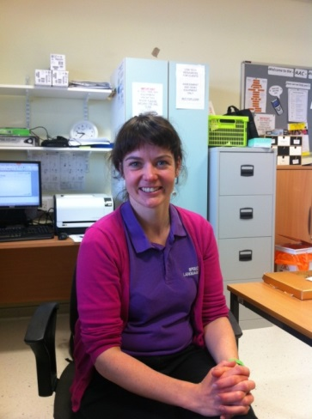
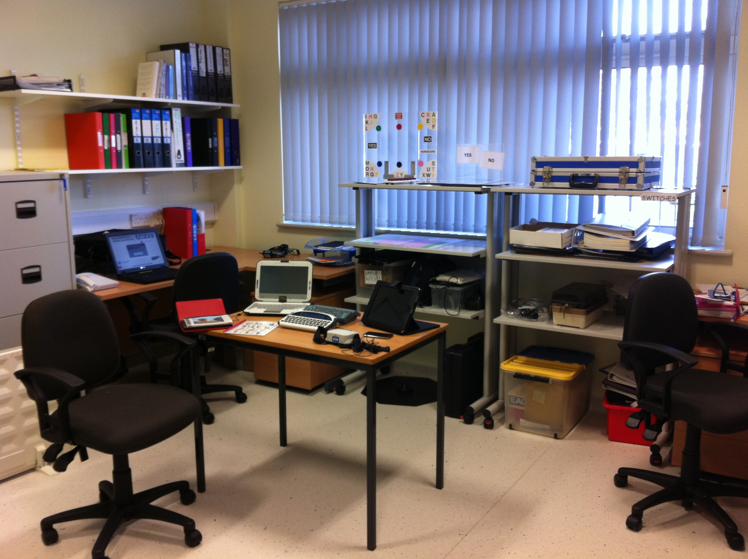
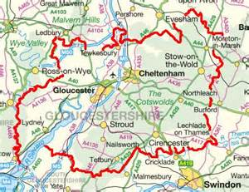
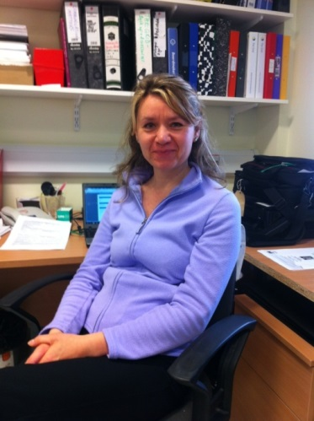
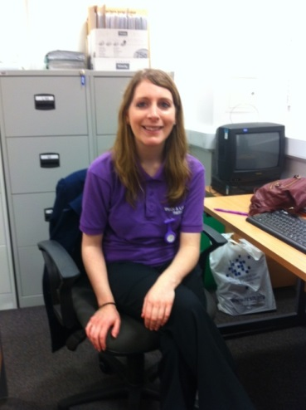
The Gloucestershire Adult SLT AAC team
Notes:
The team is an integrated part of the Adult SLT service in Glos.
We are based at the GRH but provide a countywide service including assessments and reviews from local hospital sites, patient homes and any other relevant environment.
We consist of:
1x band 7 SLT (.4 wte)
1x B6 SLT (.2 wte)
1x B3 SLTA (.4 wte)

Slide 10
Roles and responsibilities
Assistant | Band 6 | Band 7
Maintaining organisation of AAC room Making low tech charts as requested Producing crib sheets as requested Cleaning equipment Preparing equipment for assessment sessions Preparing equipment for loan Logging loaned items in loan book Managing and updating database Arranging for repair of equipment Packing up equipment for repair Putting in orders for new equipment as requested Checking new equipment on arrival Recording new equipment on database Labelling new equipment | Knowledge of range of AAC available in department and how to set up and programme each device. Routine assessments in relation to AAC and development of low tech charts to support total communication Assessment and training of patients and carers in supporting basic range of high tech AAC systems Attendance at AAC training event at least once a year. (eg CM Conference or Roadshow). Training of others at a local level. Begin to liaise with Regional Centres attend link Therapist days. | Knowledge of range of AAC available in UK Knowledge of programming skills required for each device or how to access it. Liaison with relevant companies re new equipment Liaison with Regional Centres as appropriate Complex assessments based on current research/best practice. Specialist interventions particularly for those with unusual, complicated or co-existing difficulties. Joint working with colleagues to offer second opinion Recommending equipment for purchase Monitoring budget for AAC Teaching and training of others at a local, regional and national level. Lead in audit and research related to AAC Contribution to AAC policy at a strategic and departmental level. Research development.

Slide 11
Basic costings
 | Per 1.0wte | Per Post identified
1xB7 0.4wte | 43,305 | 17,322
1xB6 0.2 wte | 36,119 | 7,223
1x B3 0.4 wte | 21,234 | 8,494
Annual equipment budget | 25000
Grand total 58039
Notes:
Basic cost accounting information from our finance department provided me with this rudimentary, and self-generated, pricing information for our service at present.
The service is an integral part of the wider SLT service however, so the equipment budget is not ring fenced.
Certain fixed costs and overheads are not included here (rent, services, A&C support etc).

Slide 12
Service specification
Exclusion criteria
Over 18s
Out of county referrals accepted
Gloucestershire GP
Open referral
Mon-Fri
08.30-16.30
Communication difficulty

Slide 13
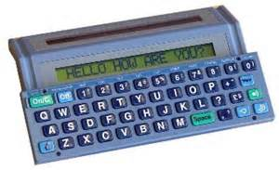
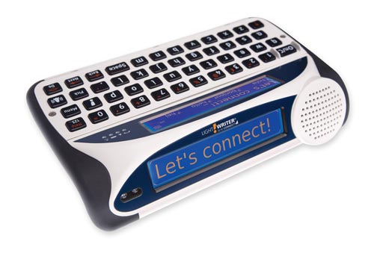
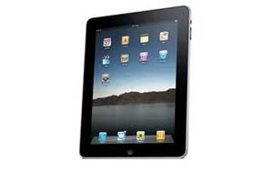
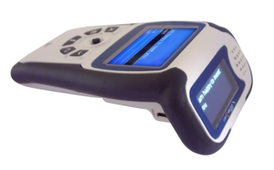
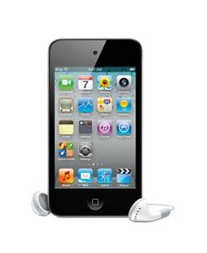
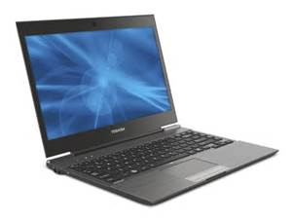
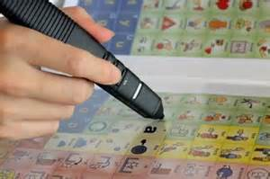
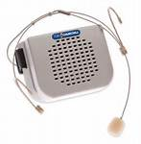
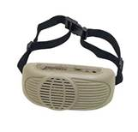
Loan Library
Equipment budget & loan library
Notes:
We provide a range of low tech equipment available for long term loan – include talking photo albums and etran frames. Our SLTa is largely responsible for putting together bespoke communication books and charts.
Largely due to the longevity of the service, we have established a large library of mid-tech and hi-tech equipment such as:
Lightwriters (SL35s and SL40s)
Lightwriter Swift
Vpens
A selection of amplifiers
We have some computer equipment too, although this is currently not available via our long term loan system.
Laptops (Grid2, Step by Step, Smart Nav, Joy cables, SWORD)
Ipads and ipod touches (with P2G and Predictable)
And our most recent addition – a tobii PC Eye Go

Slide 14
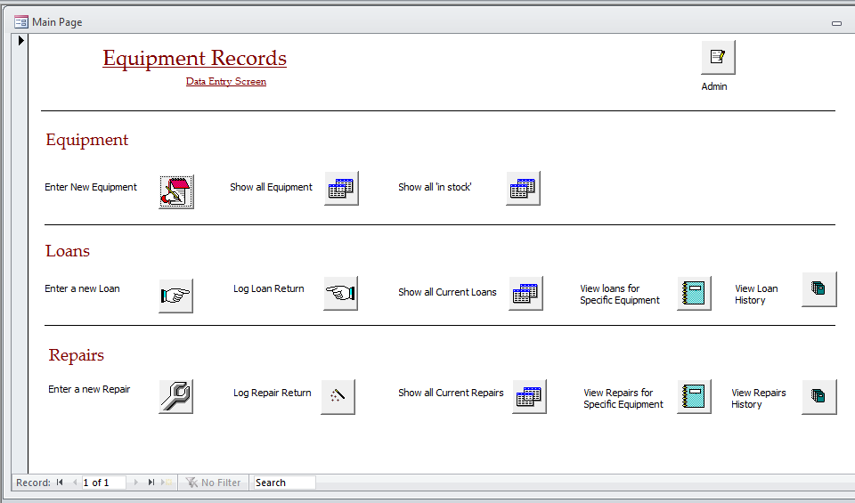
Database
Notes:
We use Microsoft Access to keep a database of the equipment.
All new equipment is logged as soon as it arrives in the department.
All loans are logged out (any items that leave the department)
All repairs are logged.
Reports can be run each year to identify the items that have been loaned, loan periods etc.
The system is used to audit the equipment library each year.

Slide 15
Support systems and equipment maintenance
Medical engineering
Information governance
Notes:
IT Support from trust IT department at present. Trial – to be reviewed in 1 year to monitor the level of suport we require an whether this will need to be charged for in future.
Medical Engineering via trust contract with acute hospital trust
Info governance – became interested in the service as we increased our stock of IT equipment
Industry companies – esp Smartbox (who are local) and TC – whom CH had a historical relationship with and who have always supported us due to our large stock of LWs

Slide 16
Our Care Pathway
Referral – direct or within service
Assessment – Specialist and joint
Loans:
Low tech/high tech
demonstration, short term and mid- term
Goal setting and review
Short term/long term issue of devices
Onward referral
Annual review
Notes:
Referrals – from external referrers and internally from therapists working in the dept
Assessment – carried out by individual SLTs, as joint assessments and as specialist assessments within the team
Loans – arranged following assessment. Some equipment (e.g. eye-gaze camera) is for demonstration only. Computers and iPads can be loaned for periods up to 3 months in order for pt and therapist to establish whether private/charitable purchase is appropriate.
Purchase and issue – following assessment equipment can be loaned on a long term basis if required and individual items can be purchased for patients if within budget
Short term and long term loans – need to be followed up by therapists until equipment is being effectively used by individuals
Onward referrals made to BCAS or involvement of industry reps where appropriate
Annual review of equipment

Slide 17
Loans Process
Equipment loan information pack
Conditions of loan form
Equipment care form
Equipment loan form (2 copies)
Departmental leaflet
Demonstration and training
Goal setting
3 month review
Annual review
Notes:
All loans are accompanied by departmental paperwork including these forms. These are not enforceable but are issued with the intention of prompting loaning therapists to discuss some of the expectations of people borrowing equipment but also to encourage patients to take consideration of the equipment and their responsibility to it.
Any therapist providing equipment is expected to fully demonstrate the device and provide training to family and carers as required. Additional training can be provided by AAC SLT.
We do expect that goals are set (??? Consistency of goal setting). There are GAS proformas available for therapists if they are unfamiliar with setting AAC goals.
We expect that issuing therapists will review clients at 3 months post-issue to ensure that clients are happy with the equipment
All equipment use is reviewed annually so we can keep track of equipment, maintain is as required, check that it is still meeting the needs of the patient and PAT test as required.

Slide 18
Annual review
Annual review
Notes:
Stock take – comparing items within the department with items on loan from it.
Review letters – sent to patients who have equipment on loan to establish whether there is an ongoing need.
Reporting from database – number of loans, equipment commonly loaned, totals (no of pieces of equipment etc)
Clear out of obsolete equipment and account for any losses
Review policies, procedures and paperwork
Report and plan strategy for coming year – in line with what we have purchased, popular items of equipment, what I perceive to be important developments in the coming year etc.
Annual review 2013 highlighted:
266 pieces of equipment
110 loans
36 communication books
34 ongoing loans that year

Slide 19
Departmental competencies and training
CM conference, AAC networks and specialist training
CM roadshows, industry demos and training
AAC Induction
Notes:
Induction to AAC is thorough:
carried out in two stages – an introduction to the service and equipment
an intro to the processes and policies
is completed when attainment of basic competencies is achieved by new staff
Basic staff competencies relate to knowledge and skills concerned with equipment within the department. The competencies range from a basic understanding of the difference between communication books and communication passports to simple programming of software such as P2G.
Bi-annual IST covering basic competencies is provided for the rest of the dept to ensure that all staff meet and maintain their competency.
Members of the AAC team attend CM roadshows and industry reps are invited to demo new equipment
AAC therapists are encouraged to attend CM, AAC SIGs, specialist training opportunities and have AAC integrated in their annual appraisal with appropriate individual development plans

Slide 20
Service development
SL40 group
Research
Glos Adult SLT AAC service
Networks
Audit
Notes:
SL40 group – runs with rep from TC to support users of SL40 in Glos.
meets 3x per year
Only possible due to funding for equipment for people locally, awareness of need and capacity made available by AAC team
Research – funding to analyse data and write up the SL40 group for publication
Audit – we intend to audit our service against national service standards developed by CM in order to present this information to our commissioners
Raising awareness – we hope to present aspects of our service and service developments at CM in order to get feedback from other people involved with AAC and to hopefully develop a network of spoke services as is available for hubs.

Slide 21
Case study 1
58y female with MND
Demo
SL40
Computer access
SL40 Scanning Connect
Referral to hub
Assessment with Smartbox
Trial with PC EyeGo
Assessment at Hub
Notes:
Diagnosed in 2011/12 and monitored by local therapist
Dec 2013:
Referral to AAC specialist
pt living alone
very independent and aware of some AAC and computer access options. Keen to explore everything.
Demonstration of all appropriate equipment (left with pt over Xmas so daughter could see it)
SL40
Swift
iPad
Smartnav
Switch access via Grid2
Jan 2014
Issue with SL40 (+training). Pt concerned about deterioration and keen to explore eye gaze so referral sent to regional hub. Long waiting times.
Feb 2014
Issues with positioning overnight. Low-tech aids devised by SLTa and provided to support with night time positioning.
April 2014
Purchase of SL40 Scanning Connect (bilingual)
Pt v concerned about computer access as she is no longer able to access the keyboard.
Grid2 demo installed. Pt using onscreen keyboard and mouse
May 2014
Joint assessment with Smartbox.
Good calibration achieved with Tobii camera.
Attempt to set pt up with dept Tobii PCEyeGo for temp computer access and training.
Unable to achieve suitable position without a floor mount
Discussion with hub
June 2014
Assessment with hub set. Key information on abilities and progress established to support assessment process.

Slide 22
How does the Glos spoke shape up?
Notes:
What are the implications of establishing specialist hubs for local AAC services both existing teams and for the future (new teams?)
Part of my motivation for sharing the model that we have established in Glos is to open up the conversation about the future for local services, to open up dialogue with local services and hubs around what is going on locally and how existing spokes can support the development of other spokes. The hubs don’t need to do all the work!
2) Where will funding come from? Will CCGs find extra cash for local services or will it need to be found from local budgets?
Unknown. My service manager is happy to provide ongoing support for our service as she appreciates the need and value. securing a funding route via CCGs would enable us to develop the service further (which existng budget limitations are preventing us from dong at present)
3) Will local services be able to evolve? Will new teams be custom built? What will be the expectation from hubs and how will that impact the way we are currently working?
Loads of scope to evolve and I look forward to having closer links to our hub and to other spokes to promote service delivery
4) What does 90% mean? Sounds like a big number but how will it break down?
In Glos, the figures are around 200 people. We currently provide aid loans for around 35 pa. Part of our service delivery includes promotion.
5) What will it mean to be a spoke????
Exciting things to come!
What do you think?

Slide 23
Any Questions?
Thanks for listening…
You can contact us on:
AAC@glos-care.nhs.uk

