Slide 1

Eye Gaze and Grid 3
13th November 2015
Neil Fitzgerald

Slide 2
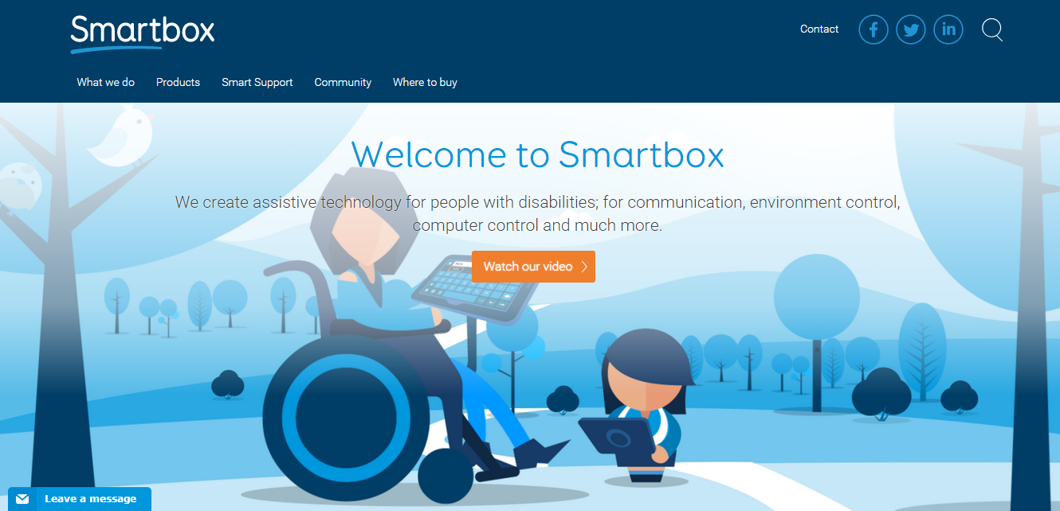


New Branding – One Company!

Slide 3



Slide 4
Grid Pad Eye 13
With Alea Intelligaze
Or Tobii PCEye Go
Complete Alea package: £5,335
Complete PCEye package: £5,375

Slide 5
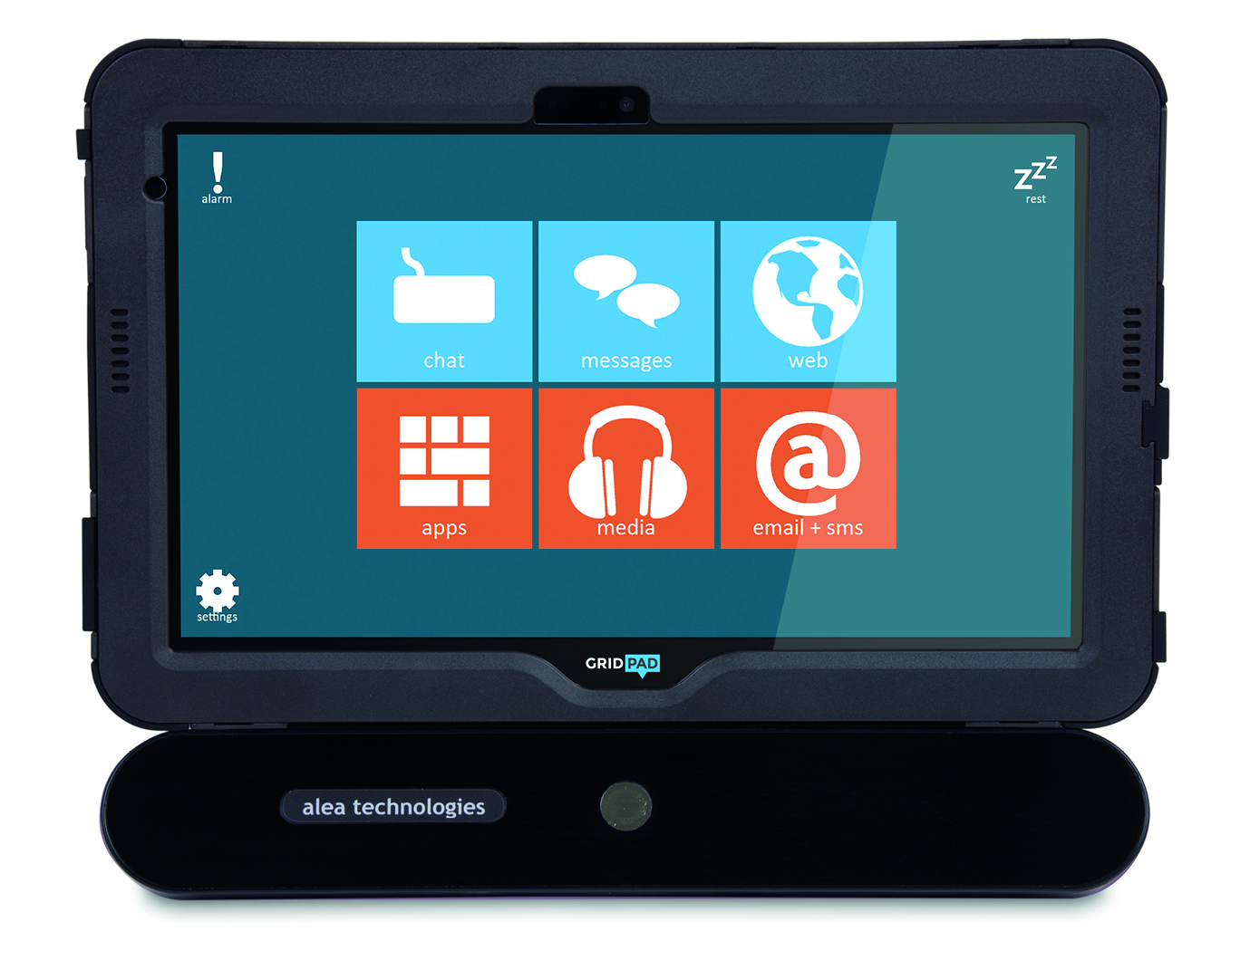
Grid Pad Eye 11
With Alea Intelligaze
Or Tobii PCEye Go
Complete package: £4,295
Complete package: £4,335

Slide 6
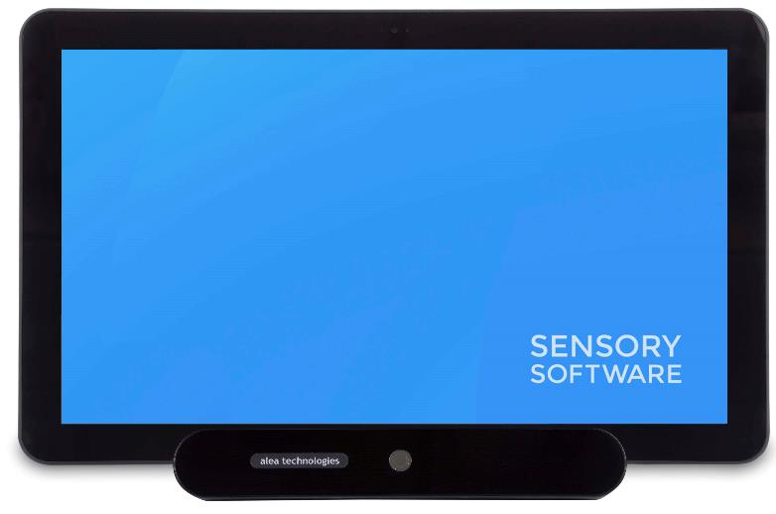
Grid Pad Eye 18
With Alea Intelligaze
Or Tobii PCEye Go
Ideal for home use
£4,335

Slide 7
Grid Pad Eye 13
With Alea Intelligaze
Or Tobii PCEye Go
myGaze version coming soon!
Complete Alea package: £5,335
Complete PCEye package: £5,375

Slide 8
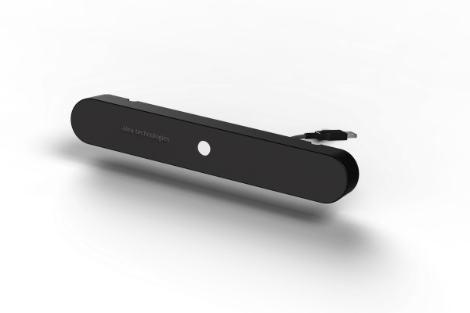
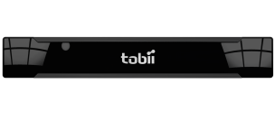
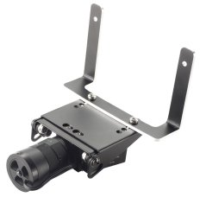
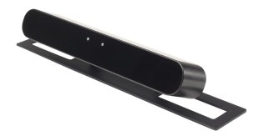
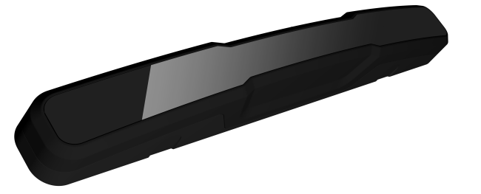
Different types of eye tracking cameras
Dark pupil
Bright pupil
Hybrid
Notes:
8

Slide 9
Comparison pt 1
The information presented is source from manufacturers documentation and is subject to change
Technical data | myGaze 2.0 [3] | myGaze 3 | PCEye Go [4] | Alea [5] | Eye Tech Tm5 [6] | Eyegaze Edge [7, 8]
Sampling rate | 30 Hz | 30 Hz | 30 Hz | 20 Hz – 40 Hz | 30 Hz | 120 Hz
Screen size range (optimum) - How large or small a screen is supported by the camera | 10” – 24” | 10-27 | 10” – 27” | 10” – 24” | 12” – 20” | 12” – 17”
Tracking box cm - The area in which the head/eyes can move and still be tracked by the camera | 32 cm x 21 cm | 50 x30 | 50 cm x 36 cm | 32 cm x 21 cm | 25 cm x 14 | 2 cm x 2 cm
Operating distance - How far away or close you can be | 50 cm – 75 cm |  | 40 cm – 90 cm | 50 cm – 75 cm | 50 cm – 70 cm | 40 cm – 80 cm
Head movement velocity - How quickly head movement can be whilst the eyes are still being tracked | 15 cm/s | 15 cm/s | 30 cm/s | 12 cm/s | Unknown | 2 cm/s
Tracking recovery time - If the eyes move out or range, then back into range, how quickly the camera responds. Some cameras have a standby time which can be altered | 250 ms | 200 ms | 100 ms | 150 ms | Unknown | 0 ms
Tracking Technology - Bright pupil or dark pupil. (See explanation below table) | Dark pupil | Dark pupil | Dark pupil / Bright pupil | Dark pupil & facial tracking | Dark pupil | Bright pupil
On-board image processing - If a camera has on board processing it can mean less strain on the computer. | No | No | Yes | No | Yes | No
Notes:
9

Slide 10
Comparison pt 2
The information presented is source from manufacturers documentation and is subject to change
Track status and Calibration details | myGaze 2.0 [3] | PCEye Go [4] | Alea [5] | Eye Tech Tm5 [6] | Eyegaze Edge [7, 8]
Track status clarity | Visualisation | Visualisation | Visualisation + Live Video | Visualisation + Live Video | Live Video
Calibration profiles | Yes | Yes | Yes | Yes | No
Moveable calibration area | No | Yes | Yes | Yes | Yes
Adjustable calibration speed | Yes (with Grid 3) | Yes | Yes | Yes | No
Step through calibration - The facilitator would be able to manually control the stages of a calibration process | Yes | Yes | Yes | Yes | No
Custom stimuli images - Used for calibration procedure | Yes | Yes | Yes | Yes | No
Number of calibration points available | 0/1/2/5/9 | 0/2/5/9 | 0/1/2/5/9/16 | 1/5/9/16 | 5/9/13
Monocular tracking - Tracking just one eye (either right or left) | Yes | Yes | Yes | Yes | Yes
Binocular tracking - Tracking both eyes together | Yes | Yes | Yes | Yes | No
Notes:
10

Slide 11
Comparison pt 3
The information presented is source from manufacturers documentation and is subject to change
Mounting and usage | myGaze 2.0 [3] | PCEye Go [4] | Alea [5] | Eye Tech Tm5 [6] | Eyegaze Edge [7, 8]
Grid 2 and Grid 3 integration - Cells are selected by simply looking at them- no visible cursor, tool to support great accuracy and efficiency | Partial (Grid 3 integration in Beta) | Full | Full | Full | Full
Mouse emulation - Eyes control a visible cursor on the screen | Yes | Yes | Yes | Yes | Yes
Advanced desktop access software | Yes (with Grid 3) | Yes | Yes | Yes (with Grid 3) | No
Ability to control secondary computer | No | No | No | No | Yes
Dwell selection | Yes | Yes | Yes | Yes | Yes
Blink selection | Yes | Yes | Yes | Yes | No
Switch selection | Yes | Yes | Yes | Yes (with Grid 3) | Yes (with Grid 2)
Laptop hinge mountable | Yes | Yes | No | Yes | No
AAC device mountable | Yes | Yes | Yes | Yes | Yes
Notes:
11

Slide 12

Let’s take a look….
Notes:
Our biggest release ever!

Slide 13
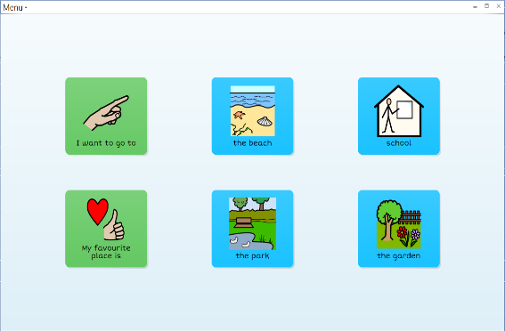
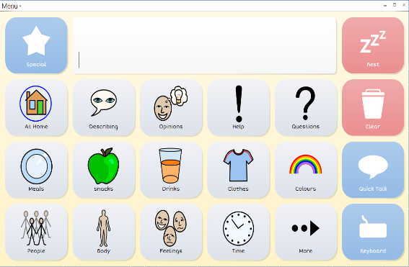
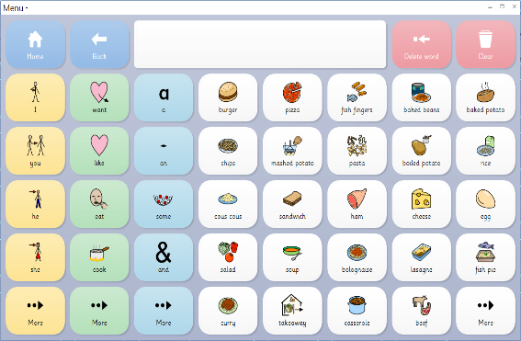
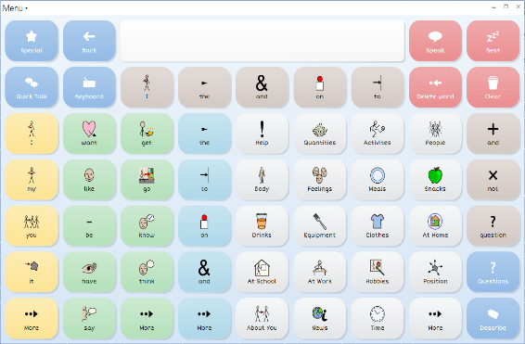
Communication Pathway
Bespoke
Topic based
Topic/transition
Core vocab
Symbol Talker A
Symbol Talker C
Symbol Talker D

