Slide 1
Funding AAC Services & equipment
AAC SIG
3rd June 2014
Oxford

Slide 2
Development of AAC Specialist Services

Slide 3
In October 2012 it was agreed by NHS England that communication aids/specialised AAC services should be included in the list of 143 specialised services that they will commission directly.

Slide 4
CRG
Clinical Reference Group (CRG)
Complex Disability Equipment
AAC Services
Prosthetics
Environmental Services
Wheelchair Services

Slide 5
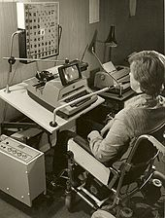
AAC SUBGROUP
Members of the AAC Subgroup:
Sally Chan (Chair)
Anna Reeves (Vice-Chair)
Cathy Harris (Chair of CM)
Alexis Egerton
Simon Judge
Gary Derwent
Judith de Ste Croix
Jemma Newman

Slide 6
NHS E
The new NHS Commissioning Framework

Slide 7
Changes to Commissioning - Theory
Government reforms were to create GP commissioning consortia called Clinical Commissioning Groups (CCGs). These were to replace Primary Care Trusts on 1st April 2013.
The majority of health services were to be commissioned at a local CCG level.
NHS England was to commissioning specialist services. These are services that would not be viable to provide at individual CCG level because of low incidence and high cost.
2012 / 13 was a period of huge activity in planning and lobbying for all types of NHS service. Communication Matters was instrumental in leading on such lobbying.

Slide 8
Implications for AAC Services
The report of the Communication Champion (2011) was an extremely detailed recommendation of how AAC services could and should work in a hub and spoke model. A detailed service specification for a hub was included in this work.
Based on the Communication Champion’s report, 90% of AAC services should be commissioned at a local level by spoke/local services, 10% at a national level by hub/specialist services.

Slide 9
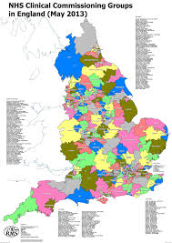
Implications for AAC Services Contd.
Local services to be funded by Clinical Commissioning Groups (CCGs), education and social care commissioners and overseen by Health and Wellbeing Boards that have been established in every Local Authority in England.
Specialist services to be funded by NHS England.

Slide 10
2013-4
Mixed pattern of commissioned services during 2013 - trend appeared to be commissioning of ‘the status quo’ – NHS services which had contracts before were commissioned at the same level

Slide 11
The Geography

Slide 12
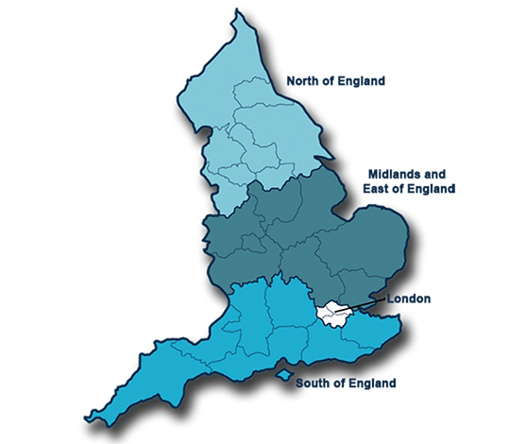
NHS Regions

Slide 13
Specialist AAC Services/Hubs
13 identified specialist services/Hubs:
North:
Newcastle Regional Communication Aid Service
Barnsley Assistive Technology
North West Assistive Technology
ACE Centre - Oldham
Midlands & East of England:
Access to Communication & Technology, Birmingham
Lincolnshire AAC Service

Slide 14
Specialist AAC Services/Hubs Contd.
London:
Compass Assistive Technology Service, Putney
Communication, Learning & Technology Service, Great Ormond Street
Assistive Communication Service, Parson’s Green
South:
Kent Children’s & Adults’ Communication & Assistive Technology Service
Chailey Heritage Clinical Services
ACE Centre - Oxford
Bristol Communication Aid Service
Dame Hannah Rogers Trust

Slide 15
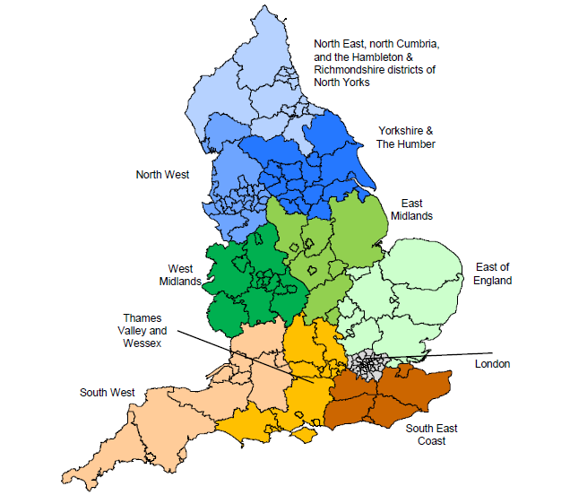
There are ten specialised commissioning regions in England and there are teams of specialised commissioners (known as Area Teams) within each region with responsibility for commissioning specialised services, including specialised AAC.

Slide 16
10 Area Teams leading on specialist services.
Cumbria, Northumberland, Tyne and Wear
South Yorkshire and Bassetlaw
Cheshire, Warrington and Wirral
East Anglia
Leicestershire and Lincolnshire
Birmingham and Black Country
Bristol, North Somerset and South Gloucestershire
Wessex
Surrey and Sussex
London

Slide 17
The Service Specifications

Slide 18
Population covered by Specialist/Hub Services
The population to whom specialised AAC services are provided are those requiring specialist assessment resulting in either a high or low tech communication aid.

Slide 19
Specialist AAC Services/Hubs
It will be the responsibility of commissioned specialist AAC services:
To provide equitable national specialist AAC services across the country for children and adults with complex communication needs.
To provide appropriate powered communication aids as a long term loan to clients for as long as the client needs and effectively uses the device.
To maintain a loan bank of powered communication aids for assessment, trial and long term loan.

Slide 20
Specialist AAC Services/Hubs
To provide specialist AAC advice and information and training to individuals, families and professionals involved in the delivery of local AAC services
To support the establishment, training and development of local AAC services

Slide 21
In order to differentiate responsibility for commissioning specialised AAC services, the following acceptance criteria have been developed and it will be the responsibility of specialised services to verify that eligibility has been met:
A severe/complex communication difficulty associated with a range of physical, cognitive, learning, or sensory deficits.
Clear discrepancy between their level of understanding and ability to speak.
In addition, an individual must:
Able to understand the purpose of a communication aid.
Have developed beyond cause and effect understanding.
Have experience of using low tech AAC which is insufficient to enable them to realise their communicative potential.

Slide 22
Where are we now?

Slide 23
Current position
£15 million per annum for specialist/hub services and provision of equipment has been secured.
Business Plans have been submitted to NHS E via the Area Teams.
These will be scrutinised by NHS E & an Oversight Panel.
Contracts would hope to be
signed in July 2014.

Slide 24
AAC subgroup
Quality Assurance Framework for local AAC Services
Data reporting to NHS E
Outcomes for services and assessments
Review of criteria for specialist services
Provision in the East of England
Working with the suppliers
Working with the 13 specialist services
List of prescribed equipment
Working towards the 5 year strategy for Complex Disability Equipment

Slide 25
Local AAC Services

Slide 26
Local AAC Services
Funding of equipment possibly from Education Health and Care Plans
Personal budgets
Funding for services – joint commissioning framework, overseen by the Health and Well Being Boards, and the Senates.
Link in with Specialist Services.

Slide 27
Health and Wellbeing Boards
Health and wellbeing boards in every upper-tier and unitary local authority.
The boards will:
have the flexibility to bring in the expertise of district councils;
require local authorities to prepare the Joint Strategic Needs Assessment (JSNA) via health and wellbeing boards;
develop a shared view about community needs and support joint commissioning of NHS, social care and public health services;
have a proposed minimum membership of elected representatives, CCGs, directors of public health, directors of adults’ and children’s services, local HealthWatch representatives and the participation of the NHS commissioning board; - be able to expand membership to include voluntary groups, clinicians and providers.

Slide 29
Healthwatch
Healthwatch launching in October 2012 is the new independent consumer champion created to gather and represent the views of the public. It:
plays a role at both national and local level.
will be independent of Government through its constitution as a committee of the Care Quality Commission (CQC).

Slide 30
Any quEstions?

